Slide 1

DriverPass System Analysis
Matthew Pool
Notes:
Welcome to the DriverPass System Analysis session. I’m Matthew Pool, the System Analyst for the DriverPass app. Thank you for being here. Today I am going to go over the system we are developing with you. The DriverPass app is designed to help students pass their driving test at the local DMV, as roughly 65% of attempts are unsuccessful. Our app will increase brand awareness, while also providing customers with up-to-date practice exams and on-the-road training and classes to help overcome this low success rate.

Slide 2

System Requirements
Functional Requirements
Users can register for a DriverPass account to log in to (or out of)
Users can register for 1 of 3 DriverPass packages
Nonfunctional Requirements
System will run on all major desktop and mobile platforms via the user’ web browser
App will use DriverPass brand’s custom font with industry-standard web font sizes
Notes:
With the DriverPass app, users will be able to register for a DriverPass online account, by simply clicking a link conveniently located at the top right of the screen labeled “Sign Up”. Once registered, the user can log in to the site to access the different training packages available from DriverPass. Once a user finds the package they desire, the user may click “Add Package” to reserve and select from the available dates and times.
The DriverPass app will run on all major desktop and mobile platforms, including (but not limited to) Microsoft Windows, Apple macOS, Linux, Apple iOS, and Google Android. The app will be accessed by the user via a web browser, such as Google Chrome, Apple Safari, Mozilla Firefox, Microsoft Edge, or Opera. The app will be utilizing DriverPass’ own custom font and will use 16px font size for body and 32px font size for major headings, as is an industry-standard and ensures easy readability for most users. This will help ensure users enjoy using the app and are more likely to follow through on making a reservation. Besides, that’s a beautiful font!

Slide 3
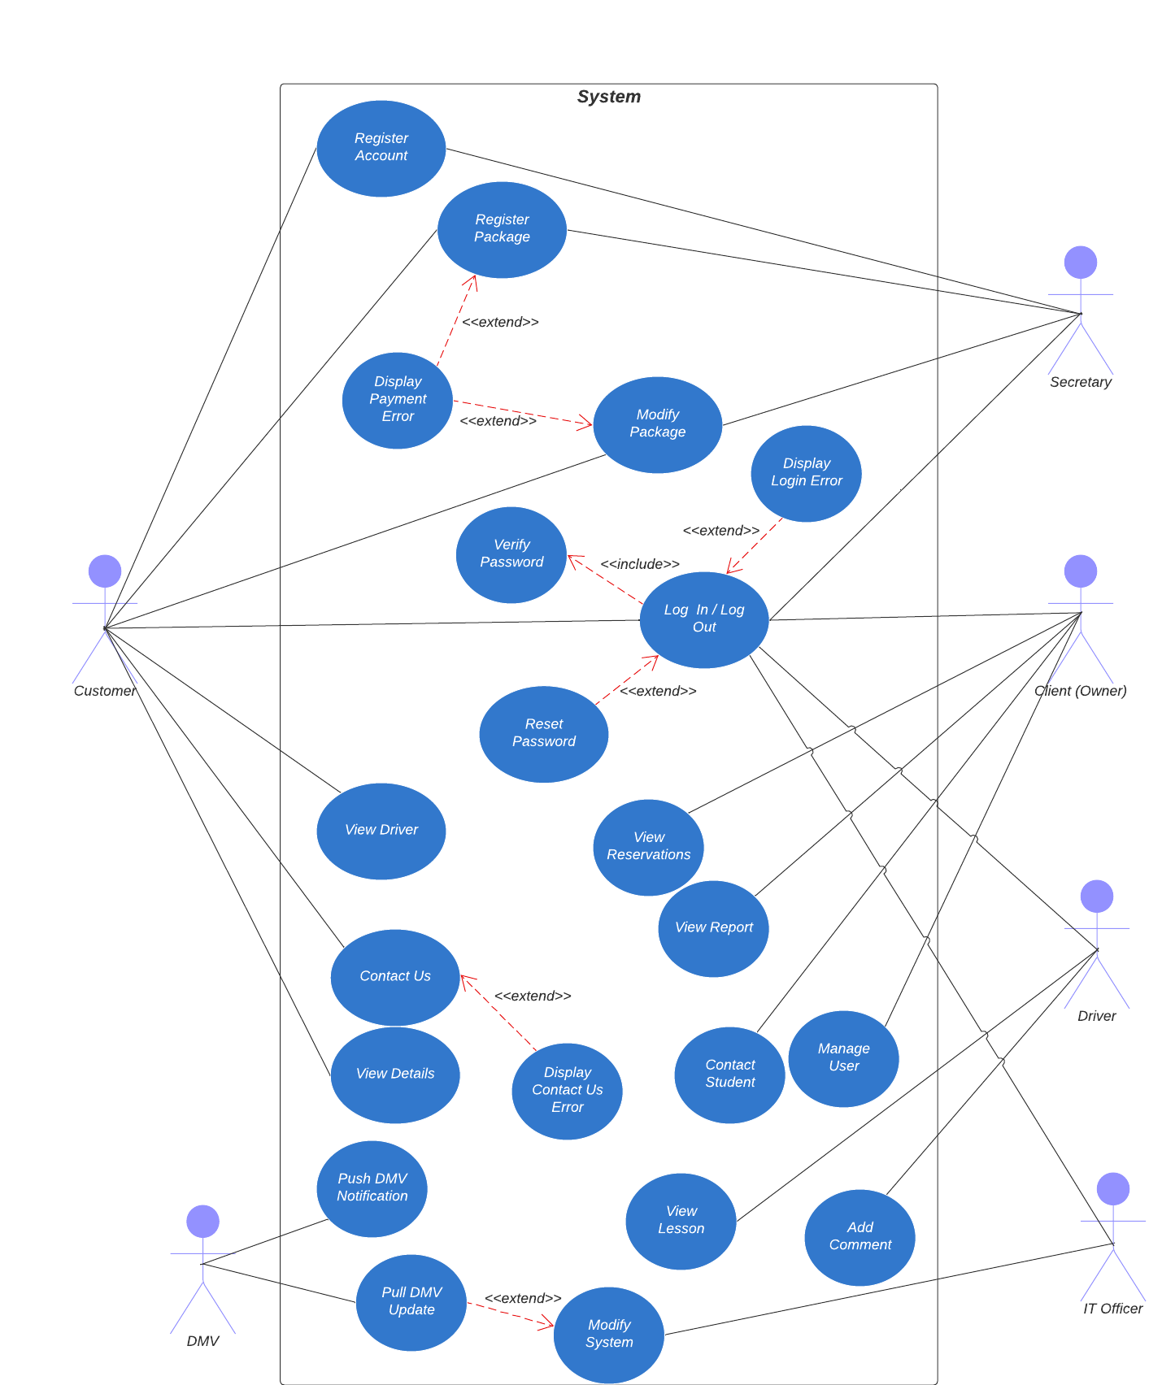
Use Case Diagram
Notes:
The system consists of the following users:
Customer: can register for an online account, and then log in or out of that account, or reset their password if they forget. Registered customers can add and then modify a DriverPass package. They can also view their driver or other details and statistics, or contact DriverPass for any reason.
Secretary: can help a customer register an account or add or modify a package with DriverPass.
Client (Owner): has administrator account to view reservations or reports, contact a student, or manage a user (including an employee).
Driver: drivers can view lessons and add comments to scheduled reservations that they are involved with
IT Officer: may modify the system, including pulling updates from the DMV
DMV: pushes notifications to DriverPass, when updates to regulatory information is available
These basic actions allow for the system envisioned by DriverPass and our design team.

Slide 4
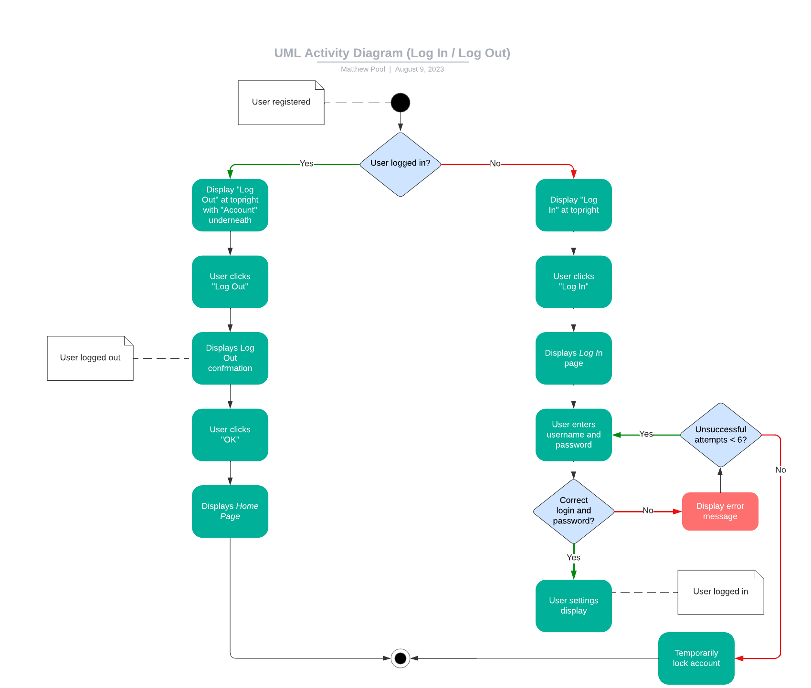
Activity Diagram
Notes:
This “Log In / Log Out” diagram shows the activities of a registered user logging in, or logging out if you already happen to be logged in. If the user is logged in, then a “Log Out” link will be displayed at the top right of the screen right above a link to access their account, naturally labeled as “Account”. If the user clicks the “Log Out” link, then a confirmation is displayed to the user, as the user is logged out of their account. The user may then click “OK” and be brought back to the home page of the DriverPass app.
In the alternative scenario, if the registered user is not already logged in to the system, then a “Log In” link will be displayed at the top right of the screen instead. Once clicked, a Log In page is displayed to the user, and the user can enter their username and password to log in to their account. If the user enters incorrect information, an error message will be displayed to the user, and after 6 failed attempts, the account will be temporarily locked, for security reasons. Upon entering the correct credentials, user settings will be shown to the (now) logged in user.
User accounts allow for an efficient and dependable framework for keeping track of customers and business users, and allow a means for the customer to purchase business packages from DriverPass.

Slide 5
Security
Security
Strong password rules enforced to all users
Passwords and other sensitive data stored on encrypted server
Functionality limited to needs of specific users
Administrator notified of security breaches or technical issues
All data fully backed up at offsite location
Notes:
Security is critically important. All DriverPass users will be required to follow strict password policies when creating account passwords, including using mixed capitalization, at least one special character and numeric digit, and must be at least 8 characters long. All sensitive data will be encrypted and stored at an offsite and secure location. Different users will be allowed functionality limited to their specific system needs.
And although, we are using best-practices and premium architectures for the DriverPass app, if there are ever any types of security breaches or technical issues, administrators will be made aware immediately, so that uptime may be maximized! Since all data is backed up to an offsite location, if there is ever a system crash or issues involving data loss, all systems can be up and running with a complete restoration of all data!

Slide 6
System Limitations
Training material/tests must stay up-to-date with DMV-compliant regulations
DriverPass app should pass all requirement tests by May 8th, 2023
Notes:
One of the important aspects of the system is to always stay up-to-date with the latest DMV-compliant regulations. This includes training materials and online test, in which case updates will be necessary periodically as the system pulls updates from the DMV, when notified. This will result in a small bit of downtime, as the system is updated and validated. This can be done during non-peak hours (late night) and should not occur frequently though.
The project deadline is set for May 8th, 2023, and the DriverPass app is set to pass all requirement tests by this time.

Slide 7
Matthew Pool System Analyst
Thank You!
Questions or Concerns?
Notes:
Thank you for your time. I hope I have met all your needs and desired functionality for the DriverPass app. Are there any questions or concerns?

